Slide 1
Food Delivery Chatbot
Group-4

Slide 2
Chatbots
A chatbot is artificial intelligence (AI) software that can imitate a natural language discussion (or chat) with a user via messaging apps, websites or mobile apps.
Why Chatbots?
For faster and transparent order processing
To know order patterns and to keep track of loyal customers
To assess customer feedback.
Foodtech chatbots are more interactive, easy to use, scale ,and can be easily automated.

Slide 3
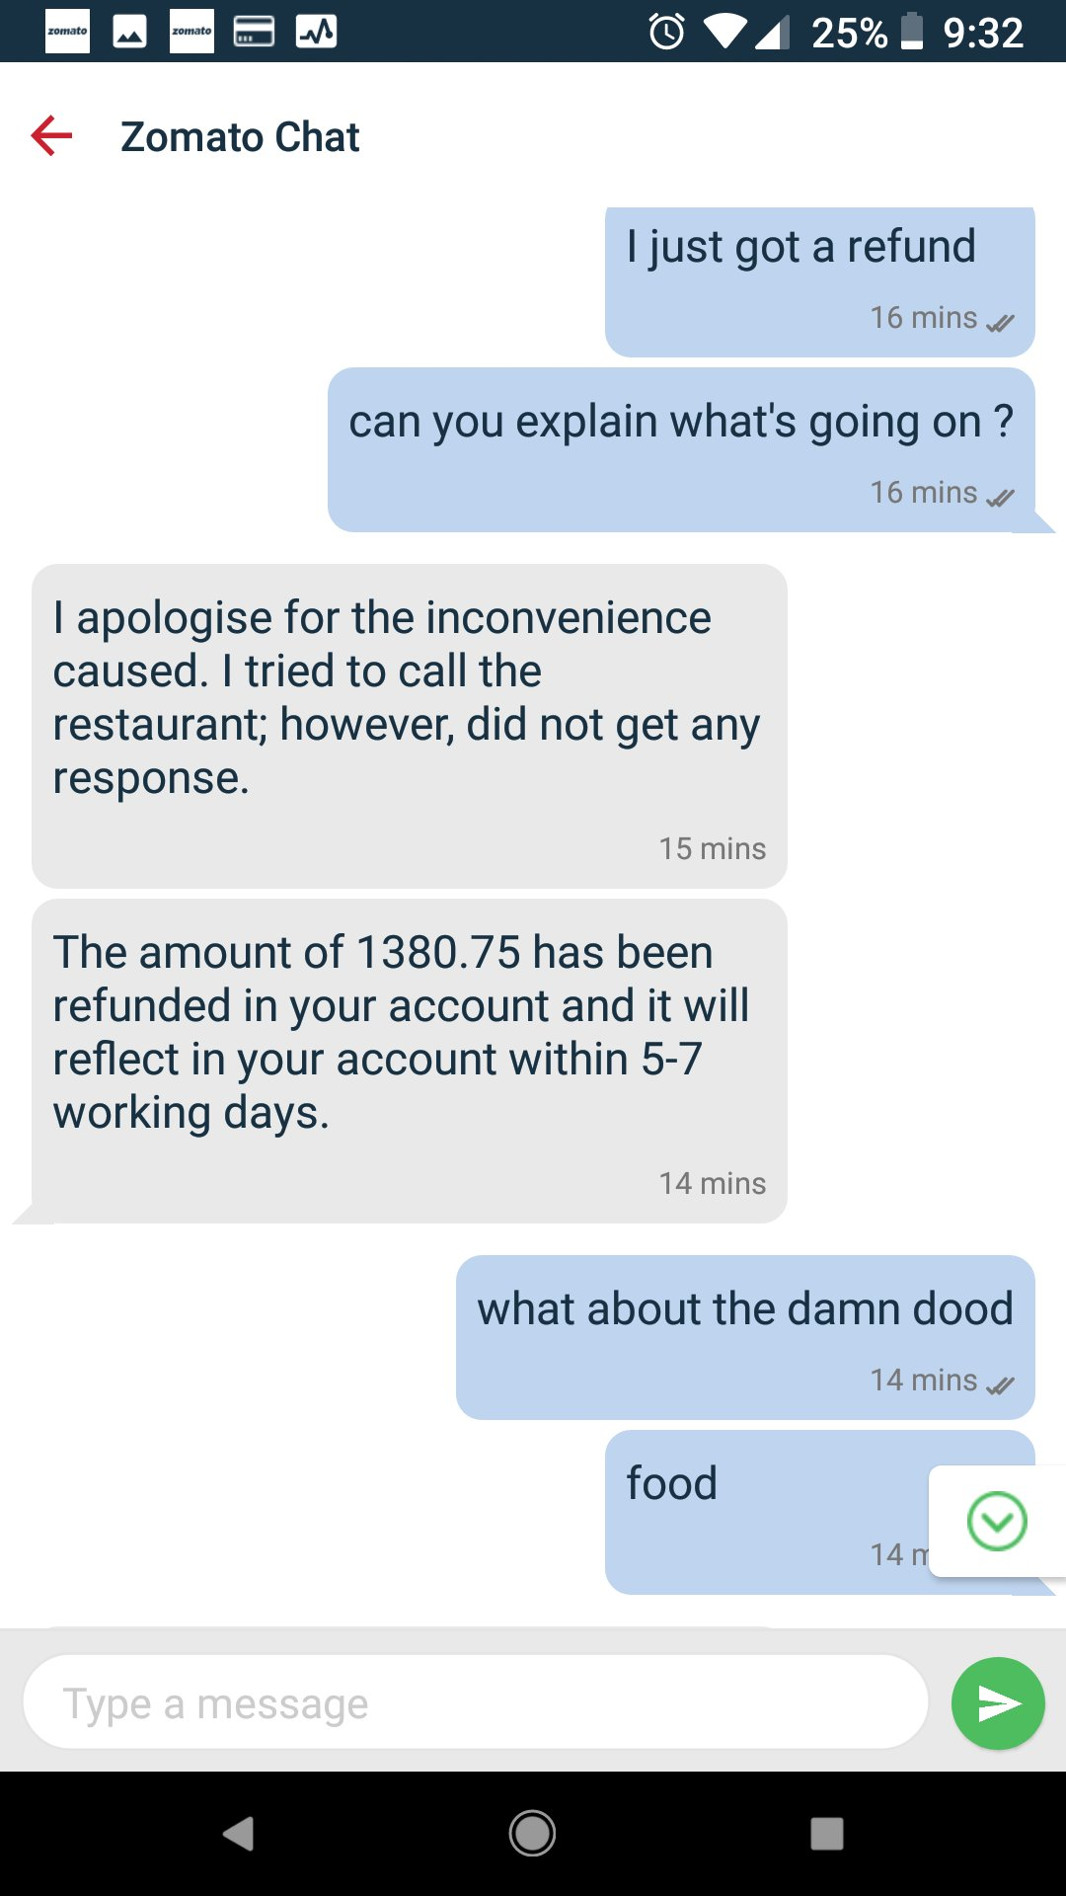
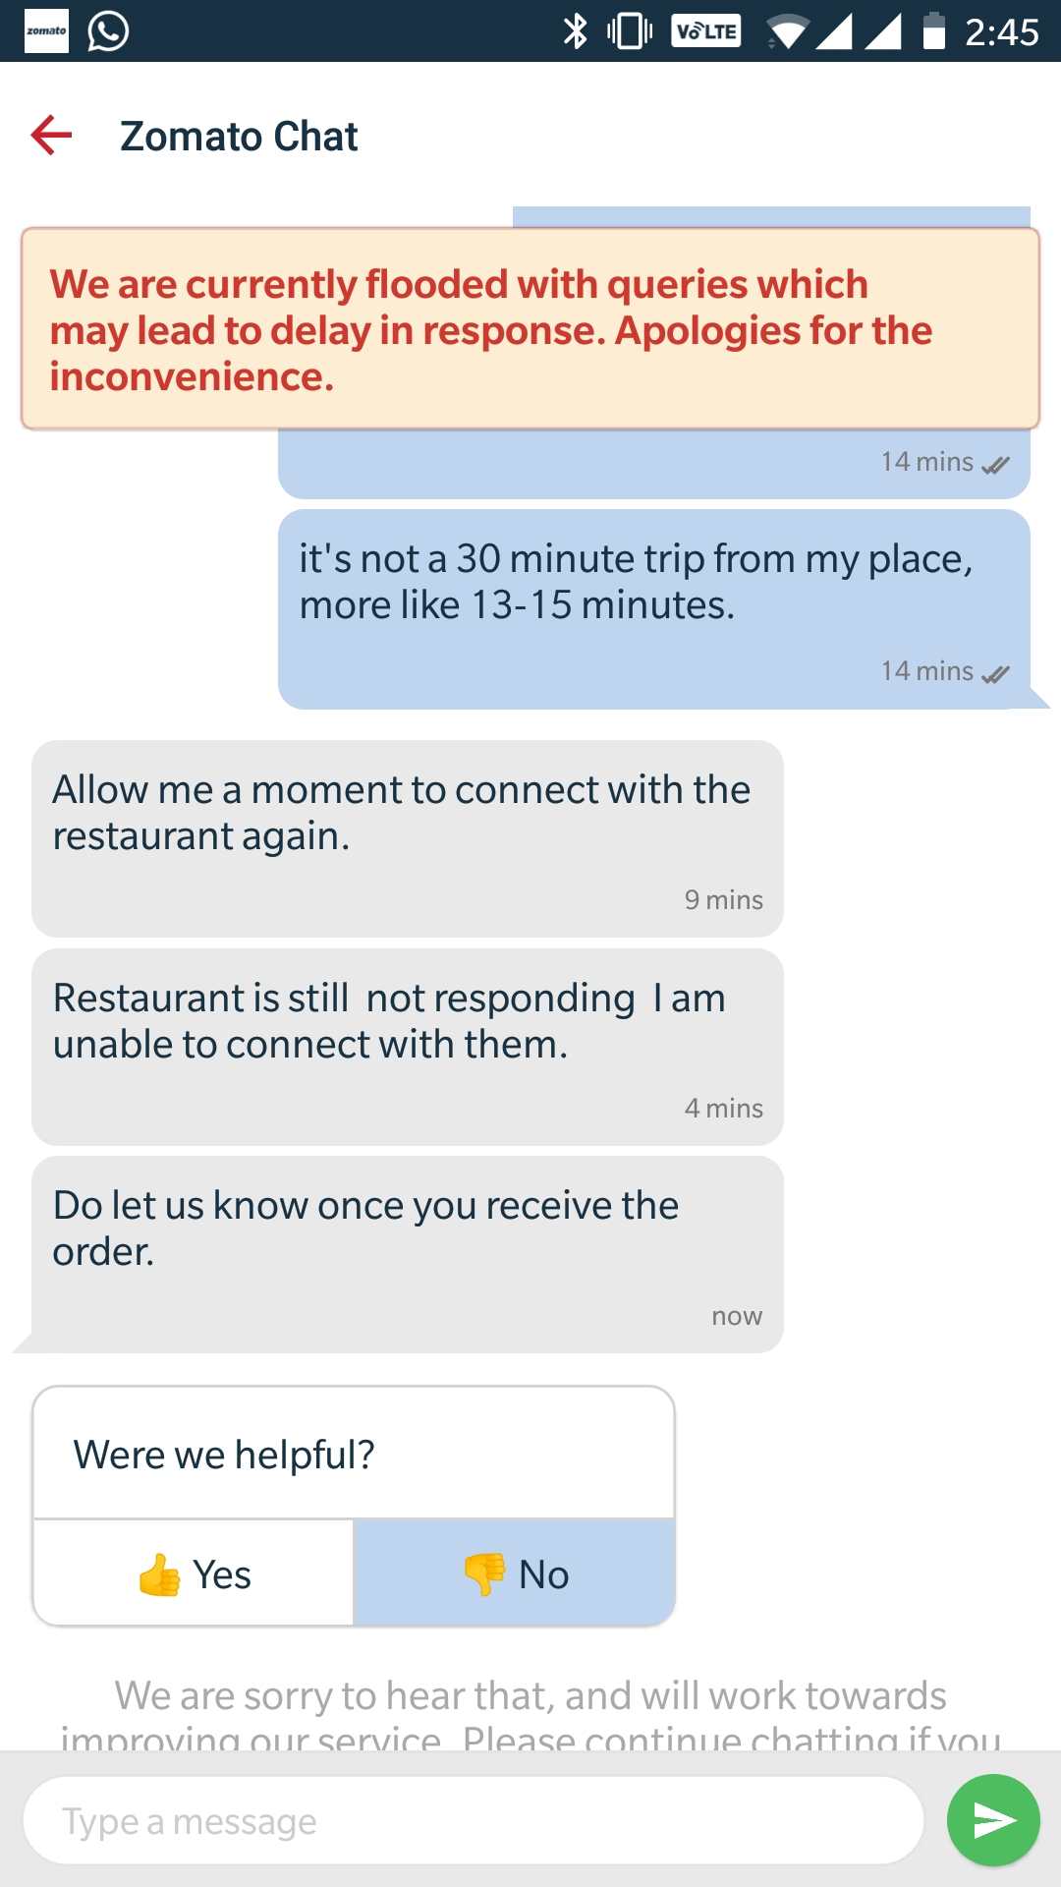
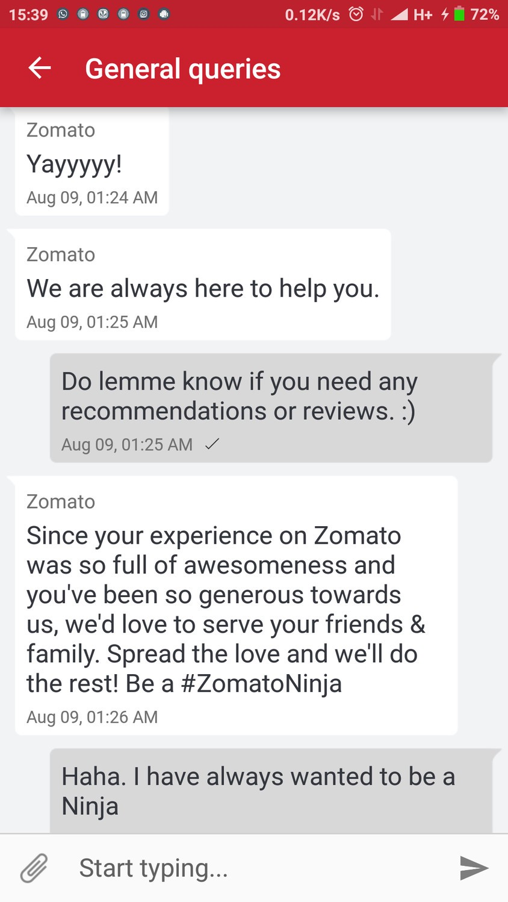
Zomato Chat:

Slide 4
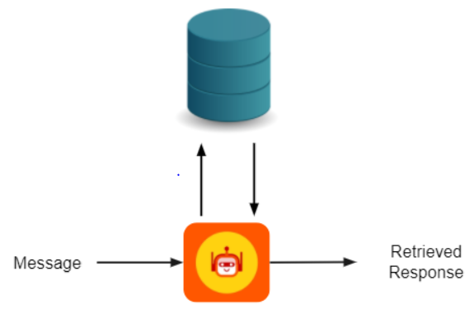
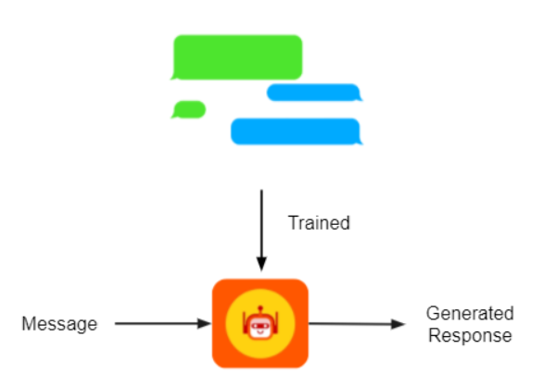
Types of Chatbots
Generative based
Generative chatbots use a combination of supervised learning, unsupervised learning & reinforcement learning. A generative chatbot is an open-domain chatbot that creates unique language combinations rather than selecting from a list of pre-defined responses.
Chatbots that use generative methods can generate new dialogue based on large amounts of conversational training data.
Retrieval based
Retrieval-based systems are limited to predefined responses.
In this we can use Intent Recognition method. Intent classification or intent recognition is the task of taking a written or spoken input, and classifying it based on what the user wants to achieve
Source: https://www.techlearn.live/

Slide 5
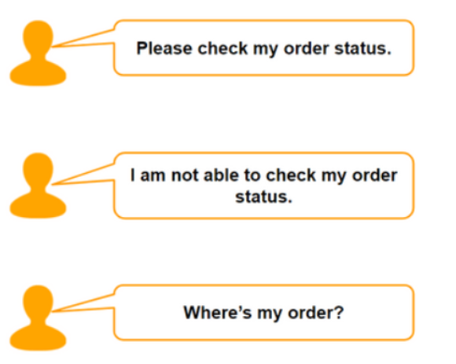
Method 2: Retrieval based chatbot
This can be done using Intent classification. Intent classification or intent recognition is the task of taking a written or spoken input, and classifying it based on what the user wants to achieve.
They all want to check their order status
They all want to check their order status
Chatbot using Intent classification
Chatbot using Intent classification
Intent.json
{"intents": [ {"tag": "greeting",
"patterns": ["Hi", "Good morning!“],
"responses": ["Hello I'm Restrobot! How can I help you?", "Hi! I'm Restrobot. How may I assist you today?"] }
Pre-processing
(normalization, stop words, lowercase, lemmatization)
Classification model to get the intent of customer’s message
Vectorization
Sentiment analysis
Generate the response based on intent and question
Restaurant database

Slide 6
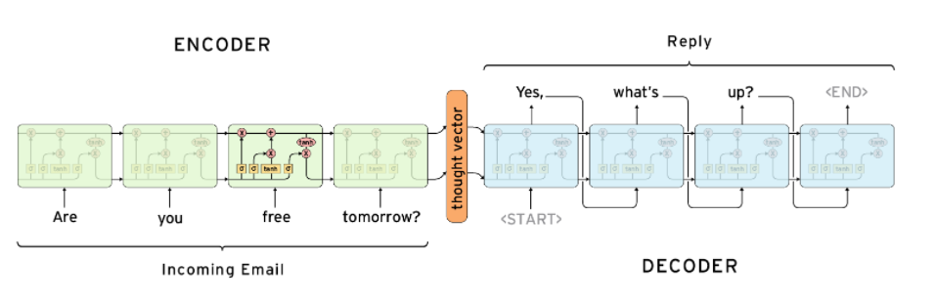
Method 1: Generative method based chatbot
As we have seen, Chatbots that use generative methods can generate new dialogue based on large amounts of conversational training data. Here, we can use Sequence to sequence learning.
Sequence to Sequence Learning:
The Sequence to Sequence model (seq2seq) consists of two RNNs - an encoder and a decoder.
The Encoder reads the input sequence, word by word and emits a context (a function of final hidden state of encoder), which would ideally capture the essence (semantic summary) of the input sequence.
Based on this context, the Decoder generates the output sequence, one word at a time while looking at the context and the previous word during each timestep.
Incoming message
Source: parctical seq2seq

Slide 7
Datasets
Json file with intents : dataset
Cornell movie dataset for Seq2Seq model : dataset

Slide 8
Using combination of both Method 1 and 2
Query/message from customer
Preprocessing and Vectorization
Intent classification
If intent present In the dataset
NO
Use seq2seq model
Yes
Generate response from intent.json

